Slide 1
CHAPTER 12 (Part 1)
Abstract Data Type

Slide 2
12-1 BACKGROUND
Computer-based problem solving means processing data
To do this, define an abstract data type (ADT)
An ADT consists of
The data type
The operation to be performed on the data
Purpose of an ADT is abstraction
Hide how the operation is performed on the data
Users of an ADT
Only need to know which operations are available for the data type
Don’t need to know how operations are performed

Slide 3
12.1.1 Simple ADTs
Many programming languages
Define some simple ADTs as parts of the language
For example, C++ defines a simple integer ADT
Its data type is an integer with predefined ranges
Several operation can be applied on this ADT
Addition, subtraction, multiplication, etc.
C++ defines these operations and what we can expect as the results

Slide 4
12.1.2 Complex ADTs
Most programming languages
Provide several simple ADTs, such as integer, real, character, pointer, and so on
But many useful complex ADTs are not provided
We will see that complex ADTs can be provided
A list ADT, a stack ADT, a queue ADT, and so on
To be efficient, these ADTs should be created and stored in a library
The concept of abstraction means:
1. A user knows what a data type can do
2. How it is done is hidden

Slide 5
12.1.3 Definition
Definition of an ADT
A data type packaged with the operations that are meaningful for the data type
Data and the operations are encapsulated, to hide them from the user
Abstract data type:
1. Definition of data
2. Definition of operations
3. Encapsulation of data and operation

Slide 6
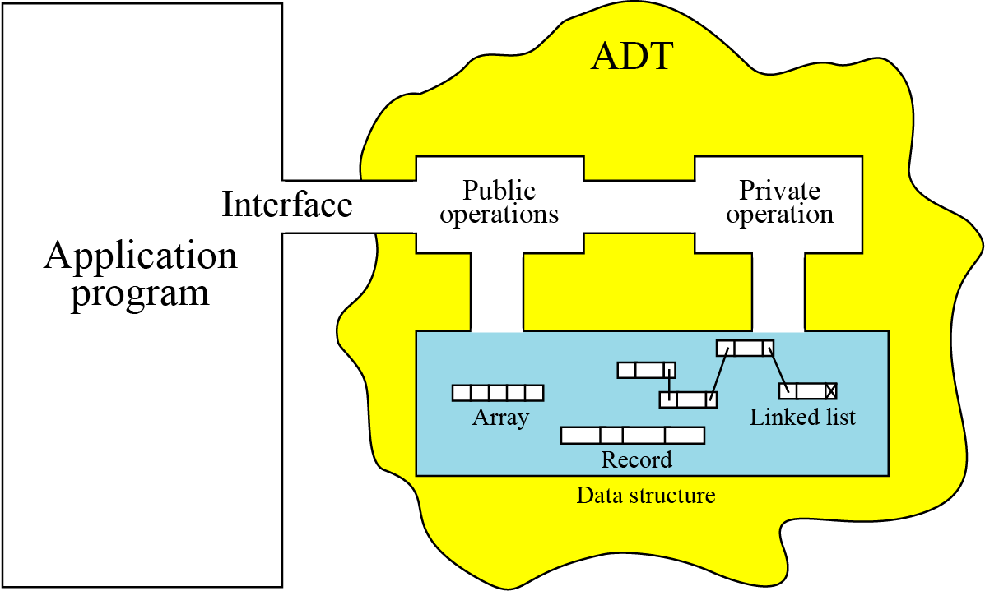
12.1.4 Model for an abstract data type
Figure 12.1 The model for an ADT

Slide 7
12.1.5 Implementation
Most programming languages
Do not provide complex ADTs
Instead they are implemented and kept in a library
This chapter
Introduces some ADTs and their applications
Briefly discusses each ADT implementation
The pseudocode algorithms of the implementations are left as challenging exercises

Slide 8
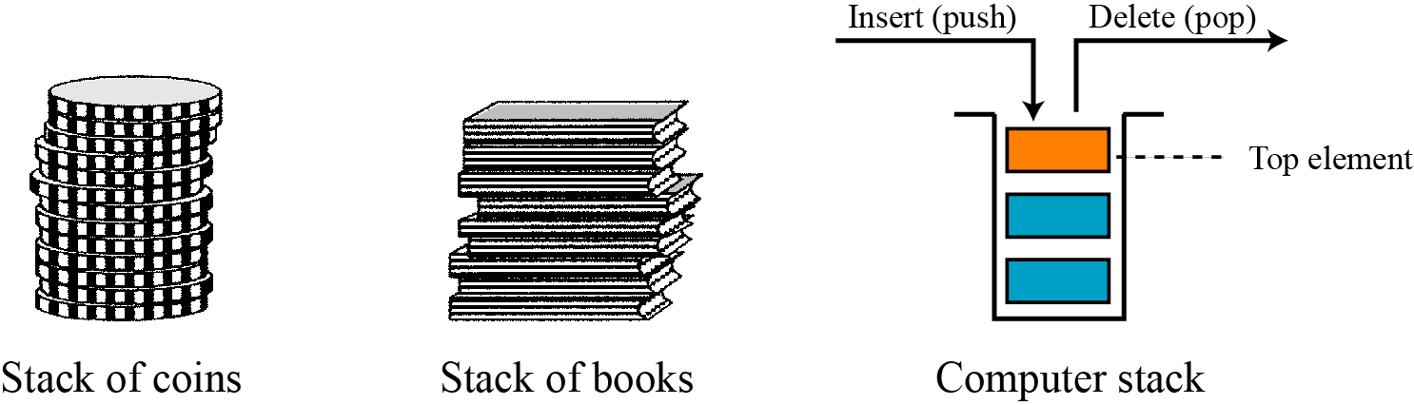
12-2 STACKS
A stack is a restricted linear list
Additions and deletions happen at one end (the top)
If we insert data items into a stack and remove them
The order of the data is reversed
Stacks are last in, first out (LIFO) data structures
Figure 12.2 Three representations of stacks

Slide 9
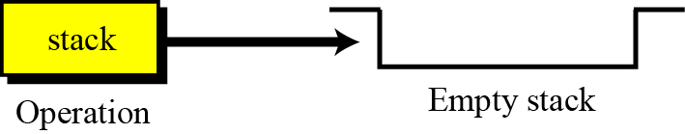
12.2.1 Operations on stacks
Four basic operations
The stack, push, pop, and empty operations
The stack operation
The stack operation creates an empty stack
Figure 12.3 Stack operation

Slide 10
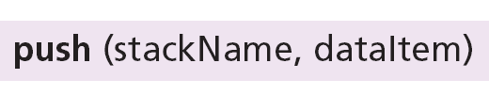
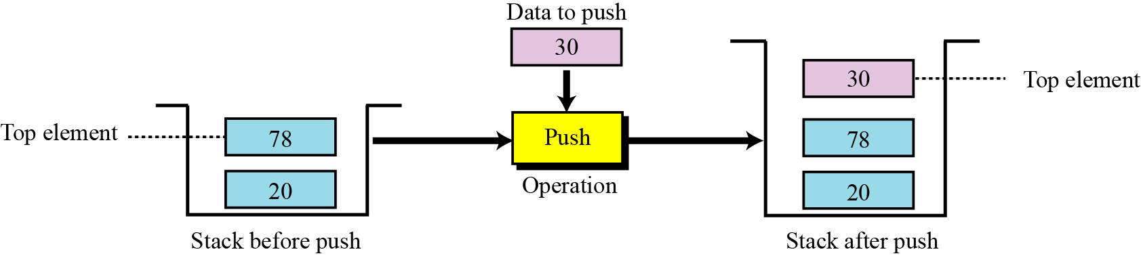
The push operation
The push operation inserts an item at the top of the stack
Figure 12.4 Push operation

Slide 11
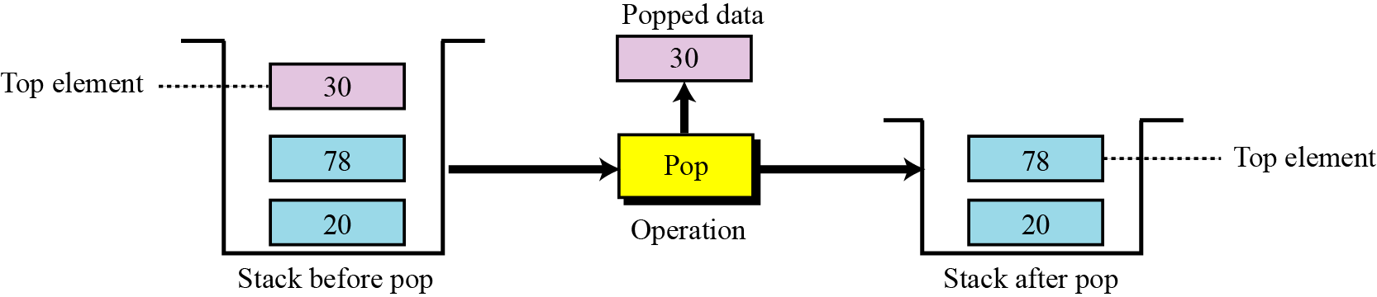
The pop operation
The pop operation deletes the item at the top of the stack
Figure 12.5 Pop operation

Slide 12
The empty operation
The empty operation checks the status of the stack
Returns true if the stack is empty
Returns false if the stack is not empty

Slide 13
12.2.2 Stack ADT
We define a stack as an ADT as shown below:

Slide 14
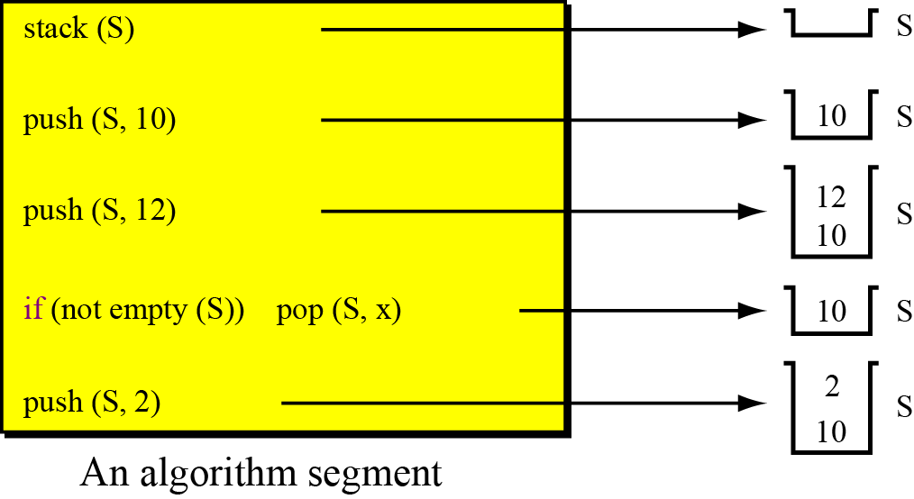
Example 12.1
A segment of an algorithm that applies the previously defined operations on a stack named S
Figure 12.6 Example 12.1
x: 12
x: 12

Slide 15
12.2.3 Stack applications
Stack applications can be classified into four categories
Reversing data
Pairing data
Postponing data usage
Backtracking steps
Reversing data items
We require that a set of data items be reordered
The first and last items are exchanged
Positions between first and last are also relatively exchanged
For example
(2, 4, 7, 1, 6, 8) becomes (8, 6, 1, 7, 4, 2)

Slide 16
Read in user input, and print it in reverse order
LIFO structure of a stack can correctly reverse input
Read user input character by character, pushing each
Pop characters from stack, printing as you go
T
A
A
C
C
C
Push C
Push A
Push T
A
C
C
Pop and print T
Pop and print A
Pop and print C

Slide 17
Algorithm: PrintReverse()
Purpose: Read input from user and print it in reverse
Pre: Input is typed one character at a time
Post: Input is printed in reverse order
Return: None
{
stack (S)
while (user has not typed enter)
{
in ← next character typed by user
push (S, in)
}
while (not empty (S))
{
pop (S, x)
print (x)
}
return
}

Slide 18
Pairing data items
We often need to pair some characters in an expression
For example
Mathematical expressions in programming language
Parentheses change the precedence of operators
Following expressions are evaluated differently because of the parentheses in the second expression:
When we type an expression with a lot of parentheses
We often forget to pair the parentheses
A compiler must check this for us
It can use a stack to check that each opening parenthesis is paired with a closing parenthesis

Slide 19
Example 12.3

Slide 20
Algorithm 12.2 Example 12.3 (continued)

Slide 21
12.2.4 Stack implementation
At the ADT level
We use the stack and its four operations
At the implementation level
We need to choose a data structure to implement it
Stack ADTs can be implemented using
An array or
A linked list

Slide 22
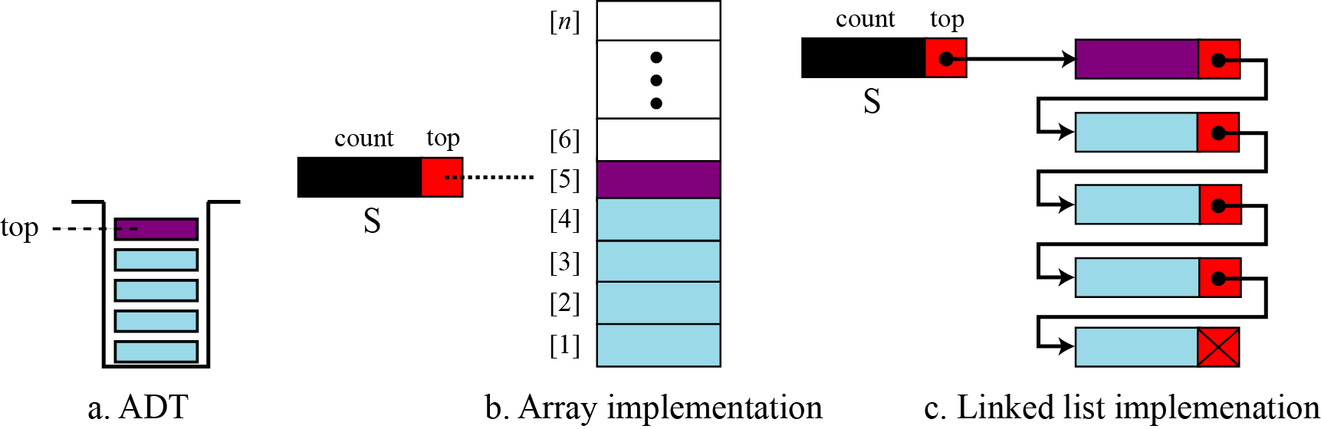
Array implementation uses a record with two fields
First field stores number of data items in the stack
Second field stores index of the top element
Linked list implementation uses a similar record
First field stores number of data items in the stack
Second field is a pointer to the top element
Figure 12.7 Stack implementations

